Slide 1
Improving Deep Learning Image Captioning
CMPE 258
By Dylan Nguyen, Sahib Singh Bhatia, Paul-Jason Mello

Slide 2
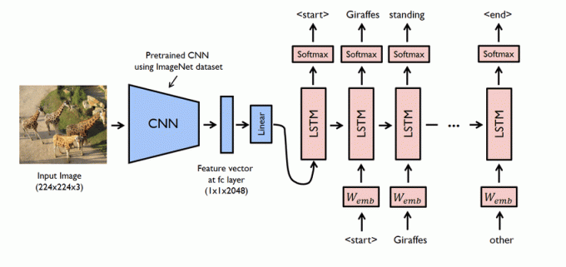
Project Description
Sahib
Improve image captioning model design.
  Preprocessing
  Model Ablations.
Automation of image captioning on datasets.
BLEU score evaluation.

Slide 3
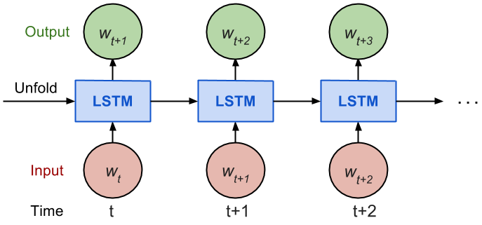
Project Objective
Paul
Ablate model architecture.
Improve base models BLEU score.
  BLEU scores describe word error rate.
Understand any limitations.
  Resources and Tools.
Solve problem incrementally.

Slide 4
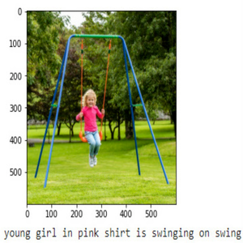
Project Tools
Paul
Dataset: Flickr8k ~8k Images and Associated Captions
Tensorflow: 2.0+
RAM: 32GB minimum for training past 8 epochs.
GPU: Nvidia RTX 2060

Slide 5
Methodology
Paul
Collect and Clean Data.
  Data is unbalanced with significant describing adjectives.
Learn model architecture.
Train model to predict image captions.
  Train text and image models separately then merge outputs.
Perform experiments on LSTM.
Evaluate experiments and measure results.

Slide 6
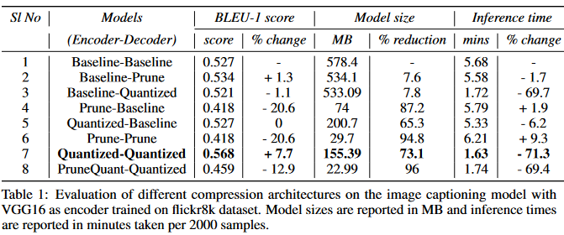
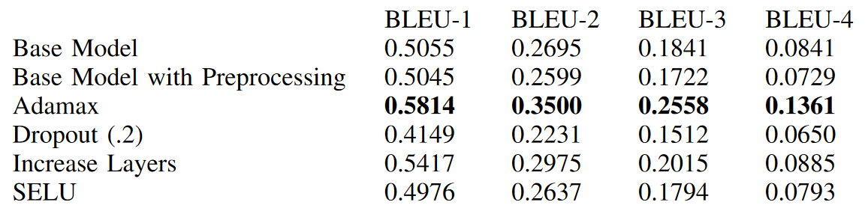
Results
Dylan
Adamax significantly improved BLEU score.
  Adamax is designed for architectures with embeddings.
Increasing layers.
  Improved feature extraction by deeper models.
Our Results
Large LSTM Reference Results
“Efficient CNN-LSTM based Image Captioning using Neural Network Compression”
Higher BLEU scores are better

Slide 7
Image Captioning Demonstration
Dylan

Slide 8
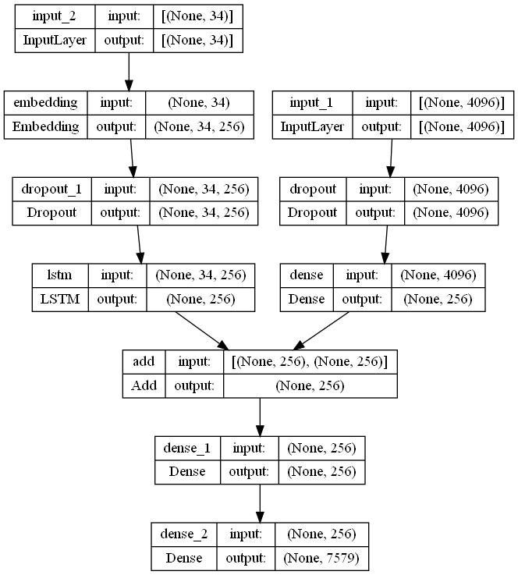
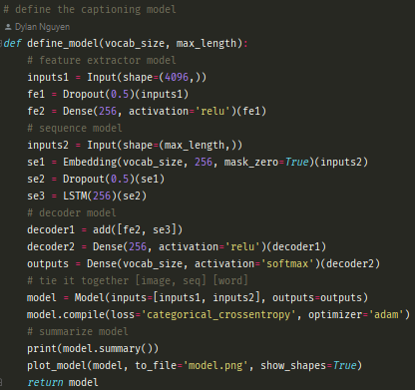
Code Walk Through
Sahib
Repository: https://github.com/DylanNguyenGit/CMPE258-Project/tree/main
= Model =

Slide 9
References
Sahib
Papineni, Kishore, et al. “Bleu.” Proceedings of the 40th Annual Meeting on Association for Computational Linguistics - ACL '02, 2001, https://doi.org/10.3115/1073083.1073135.
Hochreiter, Sepp, and Jürgen Schmidhuber. “Long Short-Term Memory.” Neural Computation, vol. 9, no. 8, 1997, pp. 1735–1780., https://doi.org/10.1162/neco.1997.9.8.1735.
Rampal, Harshit & Mohanty, Aman. (2020). Efficient CNN-LSTM based Image Captioning using Neural Network Compression.
Brownlee, Jason. “How to Develop a Deep Learning Photo Caption Generator from Scratch.” MachineLearningMastery.com, 22 Dec. 2020.
Flicker8k Dataset: https://www.kaggle.com/datasets/adityajn105/flickr8k
Our Repository: https://github.com/DylanNguyenGit/CMPE258-Project
  Try our models using the Flicker dataset.

Slide 10
Contributions
Sahib
Name | Responsibility | Contributions - Breakdown
Paul-Jason Mello | Team Coordinator Research SOTA Systems Research & Evaluate Models Exec. Summary and Ppt | Total Coding: 20% Evaluating Models Testing/verification: 50% BLEU breakdown / Testing Models Ppt: 40% Outline, collected data for slides Executive summary: 40% Outline, Rough Draft, Editing and Research Significant research of SOTA systems and model architecture
Dylan Nguyen | Research, Train, Ablate, & Evaluate Models Maintain working Environment Design Ablations Exec. Summary | Total Coding: 50% Changes to train_model and made generator cmd line callable Testing/verification: 30% Training new models and testing captions generated Ppt: 20% Demo and contributions table Executive summary: 30% Software/hardware and technical challenges Trained models for 60 hours
Sahib Singh Bhatia | Data Preprocessing Research Dataset Design Ablations Exec. Summary and Ppt | Data Preprocessing: 100% Balancing dataset for a better vocabulary by re-writing captions. Total Coding: 30% Function to generate_captions using the tokenizer Testing/verification: 20% Testing the base model with modified dataset. Ppt: 30% Project Description and Code Walkthrough Executive summary: 30%

Slide 11
Q & A

